Slide 1
Data Analytics and Accounting 2016 APLG/FSA Meeting – Savannah, GA Ann C. Dzuranin, Ph.D.

Slide 2
What are employers looking for?…

Slide 3
What do employers need?
Graduates that can think critically
Identify issues, develop questions
Determine appropriate analyses
Interpret results
Graduates that are data literate
Know what data is available, how it is stored, where it is stored, how to access it.
Understand data science and be able to bridge the gap between technical knowledge and business knowledge.
Graduates that can communicate findings

Slide 4
How do we get there?
Curriculum is already full!
Faculty may be resistant
What technology should we use?
Where do we get data?

Slide 5
Our journey…
Follow the letter or the spirit of the standard?
Could the curriculum be revamped?
Constraints:
Limited to 120 credit hours
No accounting courses can be eliminated

Slide 6
Final decision:
Add a 3 hour course “Data Analytics in Accounting”
Required for all undergraduate accounting students
Taken in their senior year.

Slide 7
Course Objectives:
Develop a decision making framework.
Understand how data is collected, created, stored, and shared by technology
Understand the processes need to develop, report, and analyze business data.
Understand how managers use business analytics to formulate and solve business problems.
Understand and identify business risks and ethical issues related to data collection, storage, and use.

Slide 8
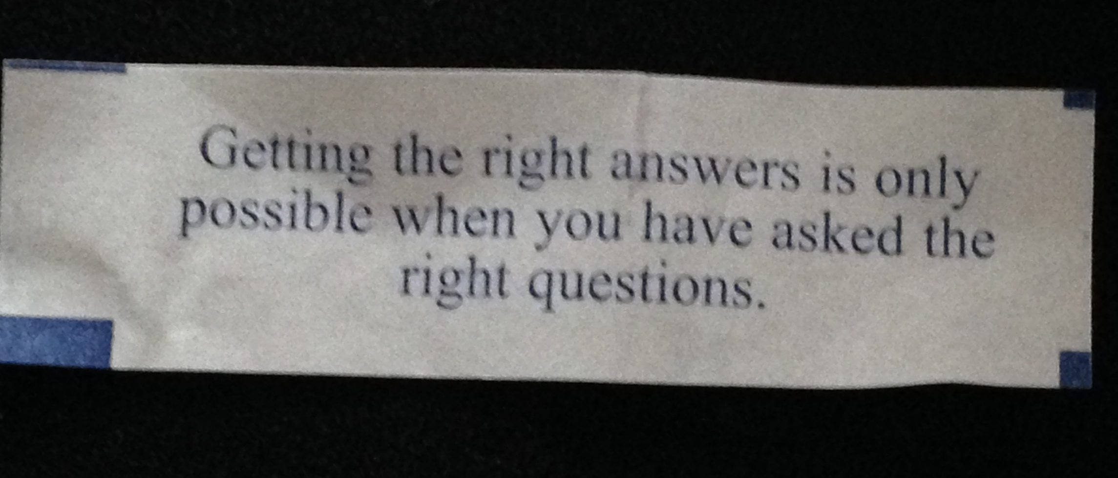
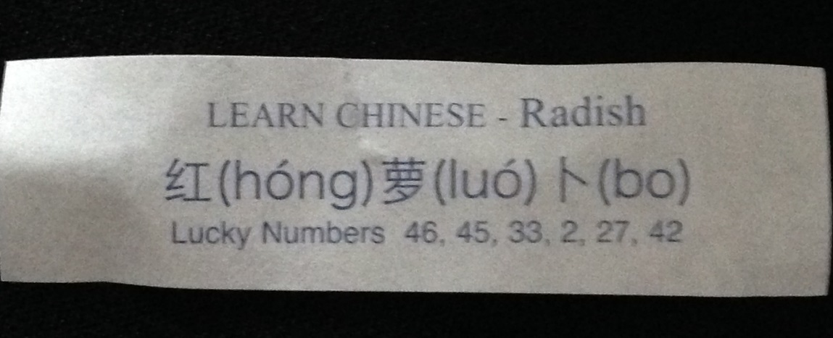
Asking Analytic Questions
“Getting the right answers is only possible when you have asked the right questions.”

Slide 9
Topics
Week | Topic
1 | Data and Accounting
2 | Data Privacy and Security Data Governance
3 | Data Warehouse
4 | Developing an “Analytics Mindset”
5 | Formulating and asking Questions
6 | Applying Critical Thinking
7 | Cleaning Data
8 | Data Visualization
9 | Descriptive Analytics and Data Visualization
10 | Descriptive Analytics – sampling and statistical inference
11 | Predictive Analytics
12 | Predictive Analytics
13 | Prescriptive Analytics
14 | Data Mining
15 | Applied Project – team based
16 | Applied Project – team based

Slide 10
Technology
Excel
Tableau (or any data visualization tool)
ACL/IDEA
Access
SPSS/SAS
SQL
Python

Slide 11
Experience working with data
Do you need “Big Data”?

Slide 12
Where can I find data?
https://www.data.gov/open-gov/
http://ohiotreasurer.gov/Transparency/Ohios-Online-Checkbook
https://data.cityofchicago.org/
https://data.cincinnati-oh.gov/Fiscal-Sustainability-Strategic-Investment/City-of-Cincinnati-Vendor-Payments/cp9c-mn9x

Slide 14
Summary –
Employers want:
Graduates that can think critically
Graduates that are data literate
Graduates that can communicate findings
Find the approach that works best for your program
Reach out to practice/industry for guidance
Don’t be afraid of the technology
Be purposeful in the integration of critical thinking skills
Be creative with data that is available

Slide 15
Contact Information: adzuranin@niu.edu

